Slide 1
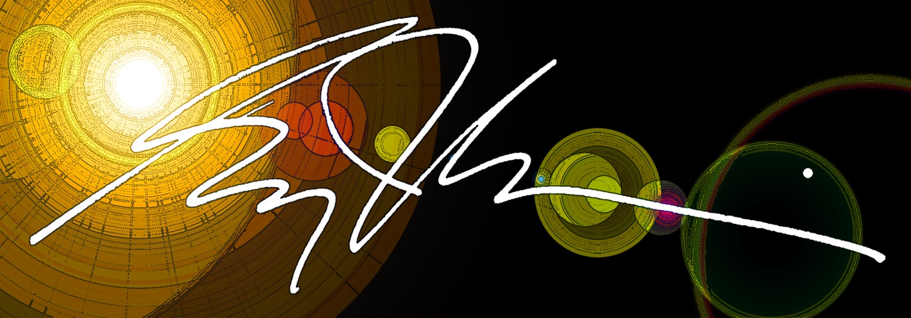
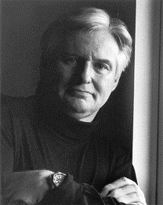
ART WITHOUT PASSPORTS Series Hosted by Greg J. Lewis
Art Presentations For Artists and Non-Artists Alike

Slide 2
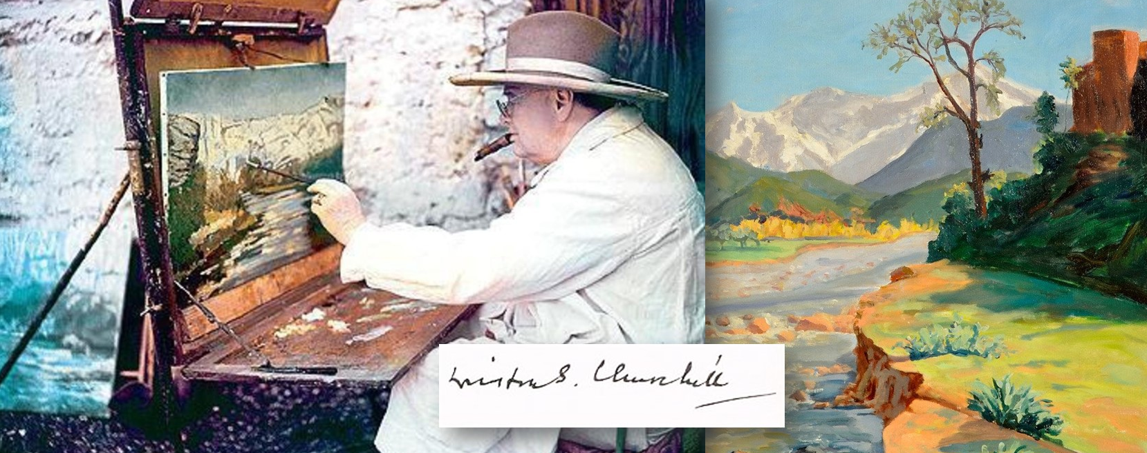
FRIDAY, JULY 16 – 3:00PM
En Plein Air - The Power of Painting Outdoors
The French term En Plein Air, or "in the open air" refers to drawings, paintings, watercolors that are completed on locations, outdoors. This presentation explores the experience of what the
eye sees and the heart and hand expresses.
Join us for an afternoon in En Plein Air...

Slide 3
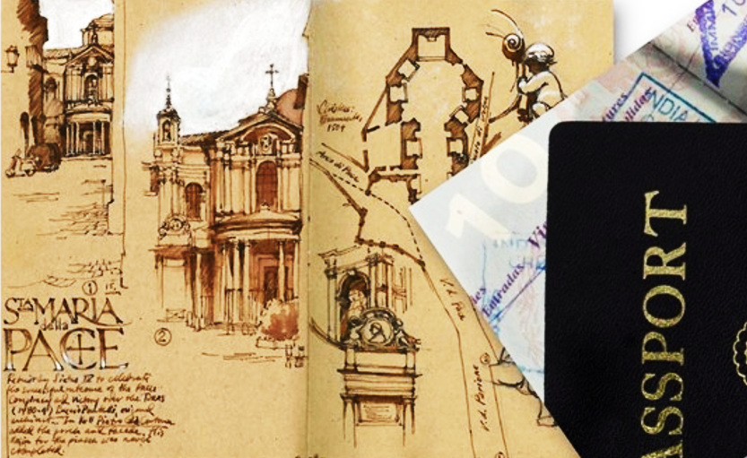
FRIDAY, JULY 23 – 3:00PM
The Travel Sketchbook: Imaginations on Paper
To capture a travel subject with your camera is one thing. But to capture that same subject with artist tools on paper is another. Always at the ready, the travel sketchbook to there to express your seeing eye’s imagination. Often written notes ocupy the art page. The time of day with its light, color and textured shadows of the scene, sparks memories to capture.
Join us for an afternoon of The Travel Sketchbook...

